Slide 1
MALARIA DETECTION
Using AI/ML techniques
Neha Dalal
MIT ADSP student
Notes:
Hello everyone, Good afternoon! My name is Neha Dalal.
I will be presenting the highlights of Malaria detection project that I implemented.

Slide 2
TABLE OF CONTENTS
01
02
03
Problem Definition
SOlution APPROACH
Model Building
04
05
06
Executive summary
Risks and challenges
Next STeps
Notes:
Here’s the agenda for the next 8 minutes…

Slide 3
Problem DEfinition
01
Notes:
Let’s start off with problem definition

Slide 4
Malaria
Contagious disease, transmitted by bites of mosquitoes
Curable but can be life-threatening
50% of world’s population is at risk
Children under 5 account for 67% of deaths
Prevalent in broad band around equator
Traditional diagnosis methods are tedious, time-consuming and expensive.
Notes:
As most of you might be aware Malaria is a life threatening disease, spread by mosquitoes.
It is pretty prevalent in tropical and subtropical regions around the equator.
50% of world’s population at risk of developing Malaria.
According to UNICEF data - Nearly every minute, a child under 5 dies of malaria

Slide 5
247.000.000
Cases of malaria in the world, 2021
UNICEF
Notes:
The threat is real as cases around the world are increasing, in 2019 there were 229 million cases whereas 2021 reported 247 million cases

Slide 6
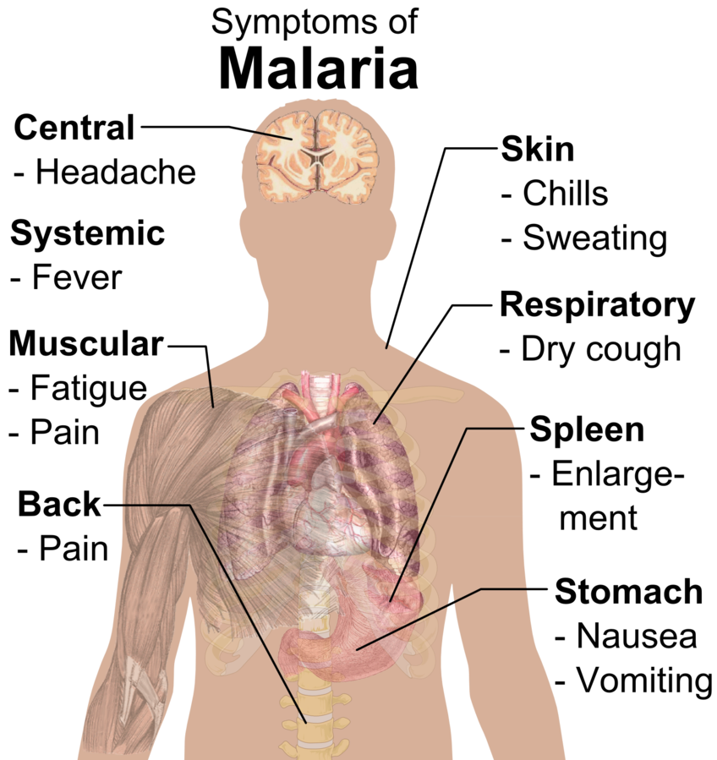
Diagnosis Challenges
Sometimes lethal parasites can stay alive in body for over a year without any symptoms and complications can be fatal.
Traditional diagnosis methods are tedious, time-consuming and expensive.
Notes:
Typically patients have symptoms shown here, but sometimes parasites can stay alive in body for over a year without any symptoms and complications can be fatal.
Traditional diagnosis methods are tedious, expensive and sometimes in-accessible.

Slide 7
objective
Build an automated system that can help with the early and accurate detection of malaria by analyzing the images of red blood cells.

Slide 8
Problem Formulation
Build an efficient computer vision model to detect malaria.
Classify the RBC cells as parasitized or uninfected.
Focus on minimizing false negatives for infected patients.
The model should be lightweight enough suitable for medical environments.
Notes:
Let’s define the specifics,
As our training data is a set of labelled images we would build a computer vision model
We have to classify RBC cells into parasitized and uninfected classes
Accuracy of detection is very important, Labeling infected patients as uninfected can result in fatal outcomes due to severity of this disease. We must focus on minimizing false negatives for parasitized class
And model should be lightweight and deployable in medical settings.

Slide 9
Solution Approach
02
Notes:
Now let’s look at solution approach

Slide 10
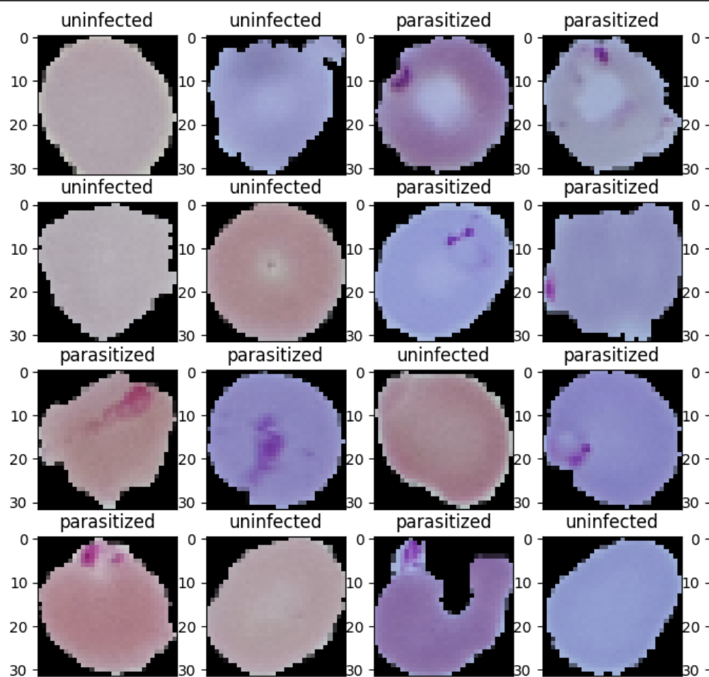
Data Exploration
RBCs
Mostly circular in shape
Some are uneven shaped
Color - shades of pink, purple, blue
Uninfected
Parasitized
Uniform average color
Have darker pigments
Human identifiable pattern
Notes:
We first explored the images of red blood cells with the labels.
We found that the images are,

Slide 11
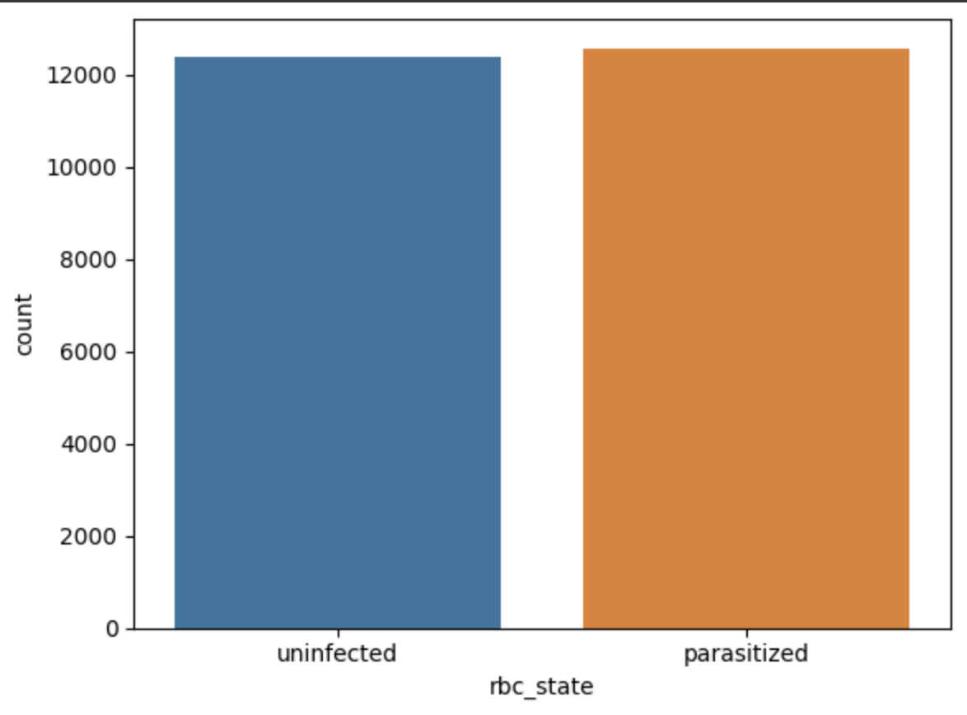
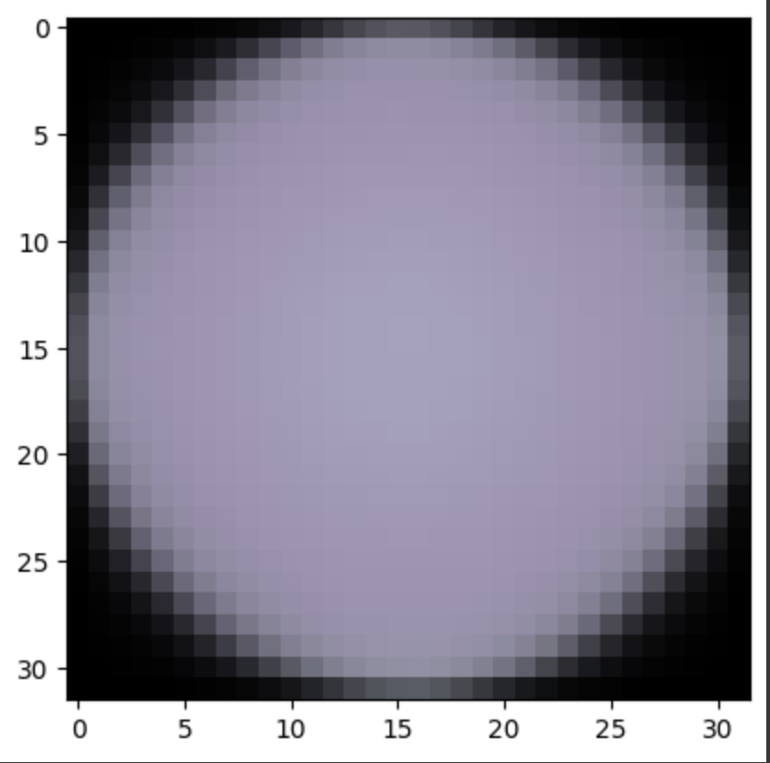
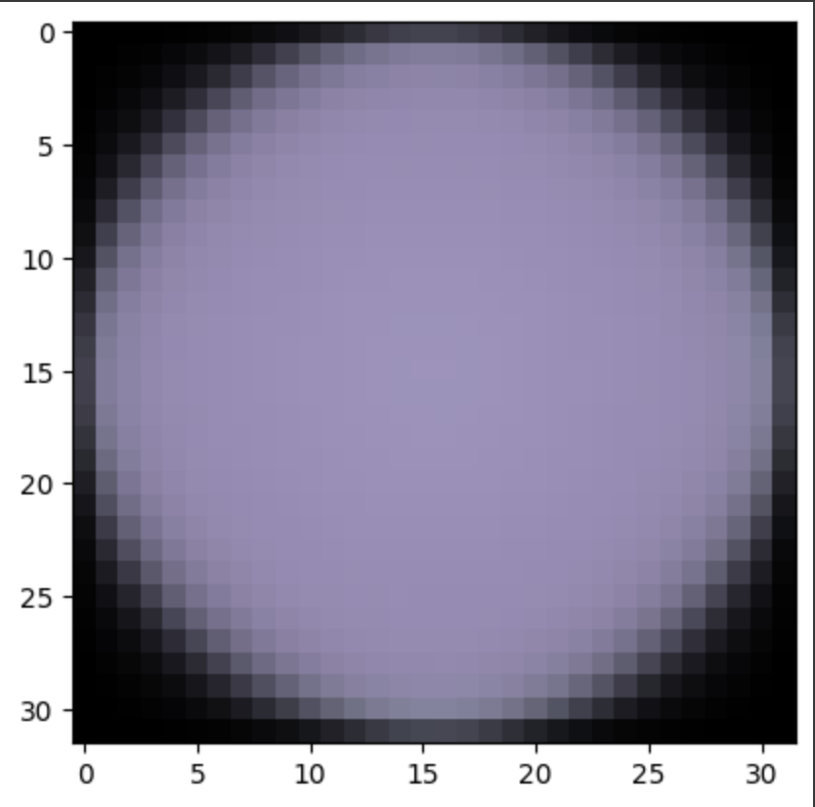
Data Exploration
Training Data balanced
Mean images circular
Parasitized mean have darker shade
Uninfected
Parasitized
Notes:
We looked at the distribution of data and mean images for each class to determine data augmentation strategy.
Data is pretty balanced here so no need to augment for balancing classes. As mean image shows circular shape augmentation with 20% rotation will be sufficient

Slide 12
Deep Learning Techniques
Input - images
Artificial Neural Network
Convolution Neural Network
Flat vector
2D images
Can overfit
Preserves spatial relations
Too complex
Feature recognition
Parameter sharing
Efficiency
Translational invariance
Generalizable
Transfer Learning options
Notes:
Let’s take a look at Deep learning techniques we considered,
We considered 2 types of NN
ANN - converts 2D images into 1D vectors and then it tries to learn the weights of the model
whereas
CNN - uses 2D images to recognize patterns
It basically learns Features Incrementally with Increasing Level of Abstraction
CNN can achieve Very High accuracy in image recognition problems with better efficiency.
Automatically detects the important features without any human supervision. It also has spatial invariance which
Publicly available transfer learning models like VGG16, ResNet50 etc can be utilized to detect lower level features and improve efficiency of model further

Slide 13
Model building
03

Slide 14
Model selection criteria
Highest accuracy in detecting ‘parasitized’ RBC cells
Minimum false positives
Model should not overfit Training data
Validation accuracy should align stablly with training data
The model should be lightweight enough suitable for medical environments.
Notes:
Model section criteria is pretty much aligned with the Problem formulation that we went over.
Also we want to make sure that the model is generic enough and does not overfit with Training data.

Slide 15
Model architecture
CNN 2D
Fully Connected
RBC Images
Forward Propagation
Layer 1
Layer 2
Layer 3
Layer 4
Sigmoid Activation
Data Pre-processing
Binary cross entropy
64 neurons + ReLU
Output
1 Neuron
128 neurons + ReLU
64 neurons + ReLU
Max Pooling 2x2
32 neurons + ReLU
Max Pooling 2x2
Max Pooling 2x2
Max Pooling 2x2
Dropout 30%
Flatten
Dense layer 64 neurons +ReLU
Loss
Uniform sizing
Normalization
HSV Conversion
Augmentation
Label
Kernel 3x3
Back Propagation
Adam Optimizer
Notes:
At high level I tried a combination of different data preprocessing techniques and CNN architecture options and made 10 attempts before choosing this model.
Model section criteria is pretty much aligned with the Problem formulation that we went over.
Also we want to make sure that the model is generic enough and does not overfit with Training data.
I will not go into the details of explaining the model here.

Slide 16
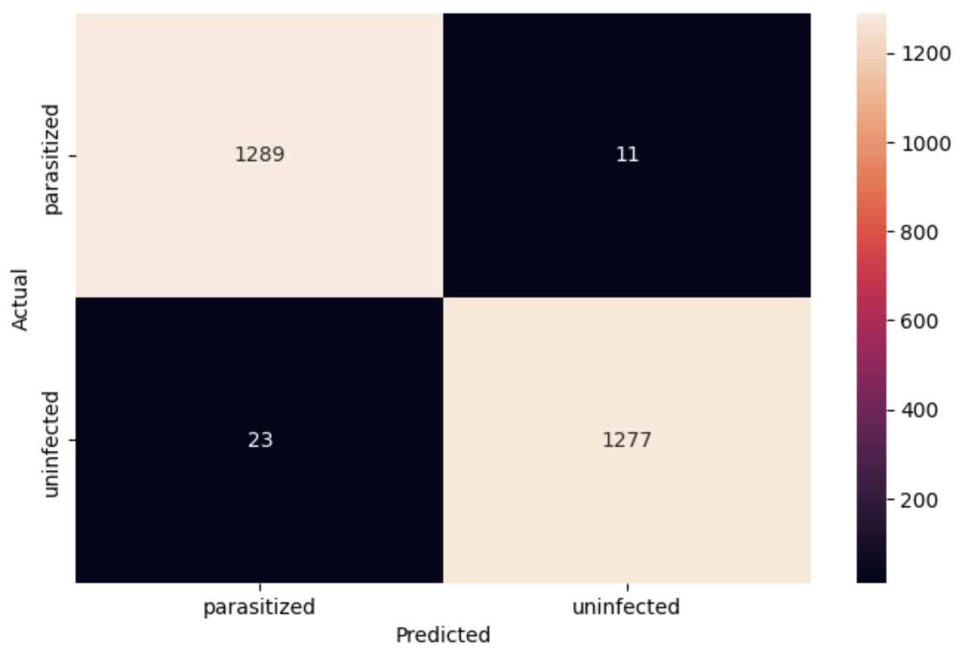
Model performance
 | False Negatives Avoided | Overall Accuracy
Parasitized | 99% | 99%
Uninfected | 98% | 99%
Notes:
Let’s go over the performance, the model is able to predict parasitized cases 99% of the times.
It did see False negative diagnosis in 11 out of 1300 parasitized patients as seen in the graph here, which is an error rate of <1%

Slide 17
Executive summary
04

Slide 18
SUMMARY
Project proposes Deep learning technique using CNN Model
Accuracy of 99% in detecting Malarial infection
The model is lightweight, can easily be deployed in medical environments.

Slide 19
Benefits, Costs, Assumptions
Consistent accuracy as compared to traditional methods
Traditional lab based methods have high recurring cost.
RDT $2.19
Microscopic $6.98
Minimal recurring cost to maintain this model.
Model can evolve with data from diverse datasets
Low computational requirements

Slide 20
Risks and challenges
05

Slide 21
Risks / challanges
Recommended model error rate of 1%, miss-diagnosis can be dangerous in high risk patients.
Consider more accurate tests for such patients
Performance is aligned to provided training / test data
Depending on the severity of endemic immunity of humans and impact on RBCs may vary
Must continue to train and evolve our model using representations from diverse datasets

Slide 22
Next steps
06

Slide 23
Further analysis
Validate the model using data from various regions
Review False negative images with skilled pathologists and get insights to improve model
More hyperparameter tuning and data augmentation techniques
Build variety of models with HSV images
Try other transfer learning models ResNet50 and EfficientNet
Notes:
Several hyperparameters to tune: step size(learning rate), regularization/stopping, width, depth, dropout, probably try Spatial Dropout, whole feature maps themselves are randomly dropped

Slide 24
— J.B.S. Haldane
(English geneticist and biometrician)
Help them help us!
“Early diagnosis of disease is the business of the general public even more than of the medical profession.”
Notes:
Would like to end with quote from British-indian scientist and one of the founders of Neo-Darwinism, J.B.S. Haldane:
“Early diagnosis of disease is the business of the general public even more than of the medical profession.”
That’s absolute fact , we need to do everything we can to help medical professionals so they can help us better.

Slide 25
Questions

Slide 26
Appendix

Slide 27
Model options tried
preprocessing
HSV colorspace
Gaussian Blur
Bilateral blur
Normalization
Augmentation
Architecture
Activation
Relu / leakyRelu
Depth of hidden layers
Maxpooling
Batch Normalization
Adam Optimizer
Dropout layer
Transfer Learning with VGG16
Notes:
At high level we tried a combination of different data preprocessing techniques and architecture options.
____
HSV color space corresponds better to how people experience color than the RGB color space does
Normalization - Exploding vanishing gradient
Gaussian Blur is used typically to reduce image noise and reduce detail.
Bilateral Blur is edge-preserving, and noise-reducing smoothing filter. It preserves sharp edges while discarding the weak ones.
Activation adds non-Linearity to the model
ReLU = max(0, x)
Leaky ReLU = only useful where the data has a lot of noise or outliers

Slide 28
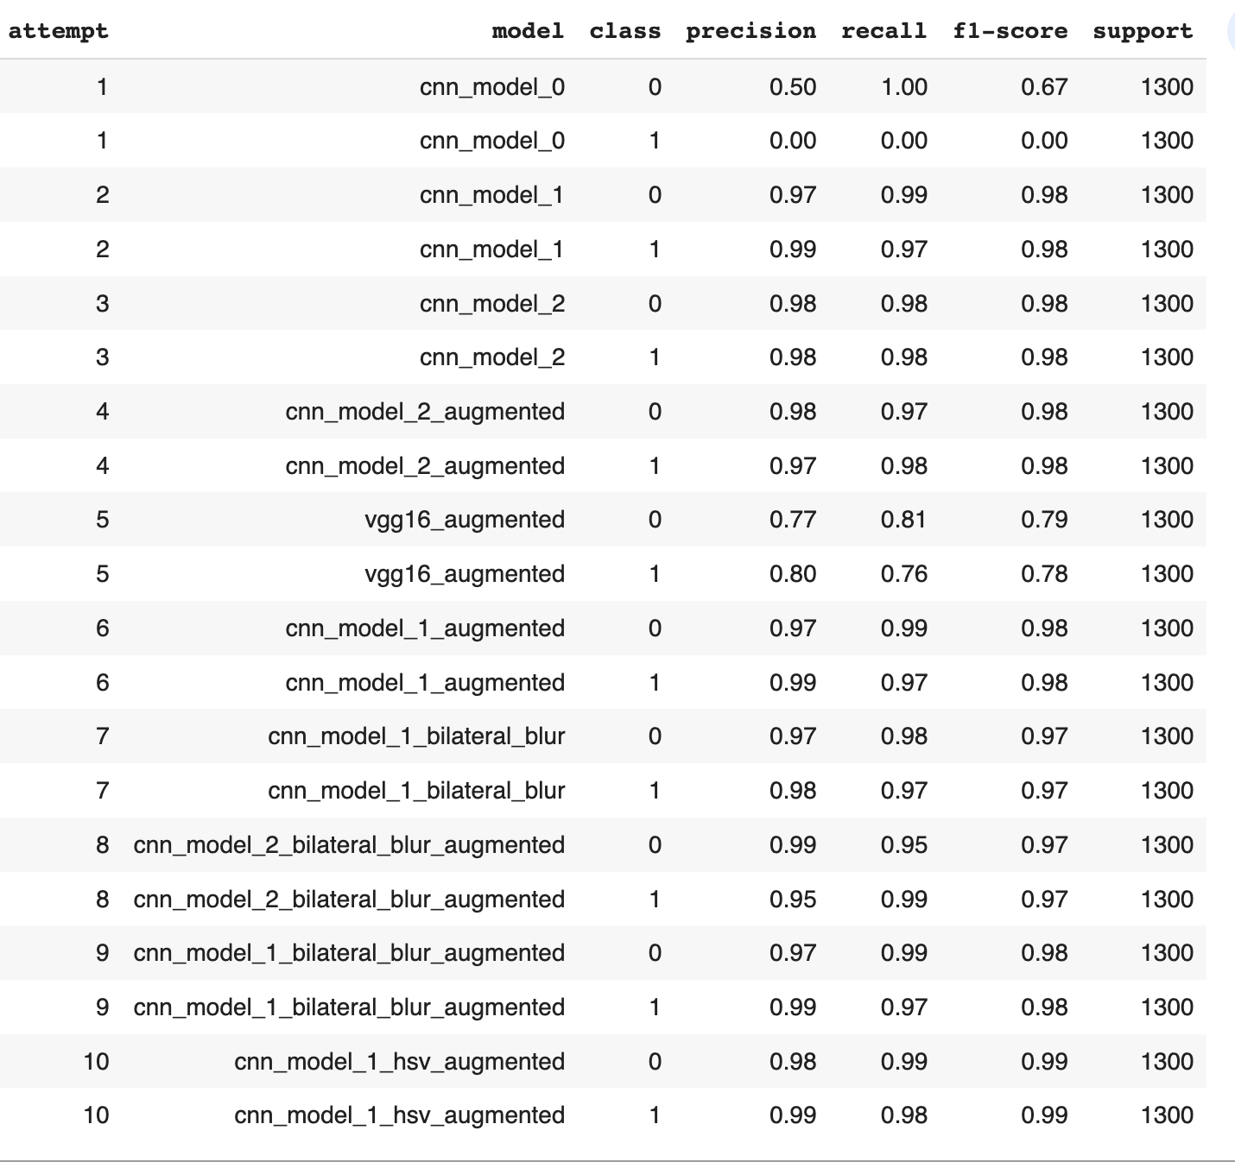
Model comparison

Slide 29
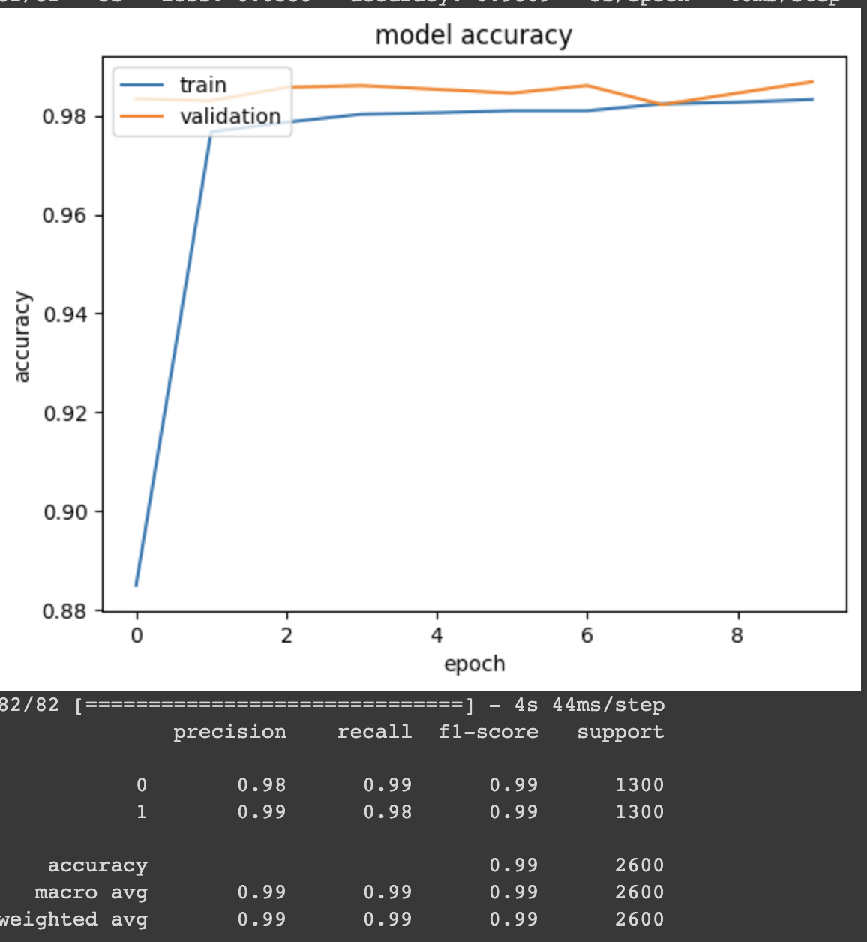
solution performance

Slide 30
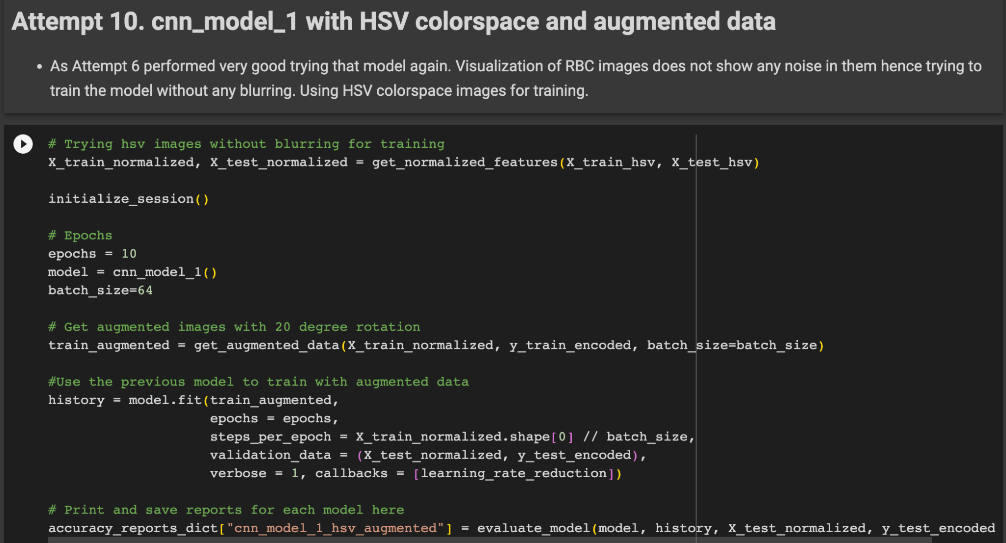
solution code highlights

Slide 31
references
Center for Disease Control and Prevention
World Health Organization
Bio Med Central - Malaria Journal
Bio Med Central - Infectious Diseases of Poverty
Wikipedia
UNICEF
Unsupervised Learning of Hierarchical Representations with Convolutional Deep Belief Networks By Honglak Lee, Roger Grosse, Rajesh Ranganath, and Andrew Y. Ng

Slide 32
THANKS!
Do you have any questions? youremail@freepik.com
+91 620 421 838
yourcompany.com
Please keep this slide for attribution

